Slide 1
PyMol and Visual Studio Code Intro
Ian Anderson
Originally Created by Fatima Hitawala in 2024 (Thank you!)

Slide 2
PyMol

Slide 3
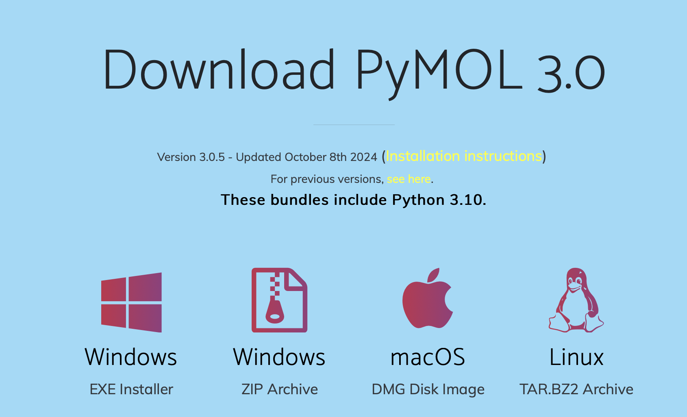
Installation at pymol.org

Slide 4
What is PyMol?
Molecular visualization software
Is built on Python under the hood
Commands are written in python using pymol library for extra functionality
Has a conda installation: conda install -c schrodinger -c conda-forge pymol
Everything you can do in pymol you can do in python!
Practically, PyMol is of great use in seeing what your protein, small molecule, etc. structures look like.
For AI tools, that may result in diagnosing the viability of designs & predicted structures.
For experimental work, this can be useful for mutating residues in silico, looking into hydrogen bond networks, etc.

Slide 5
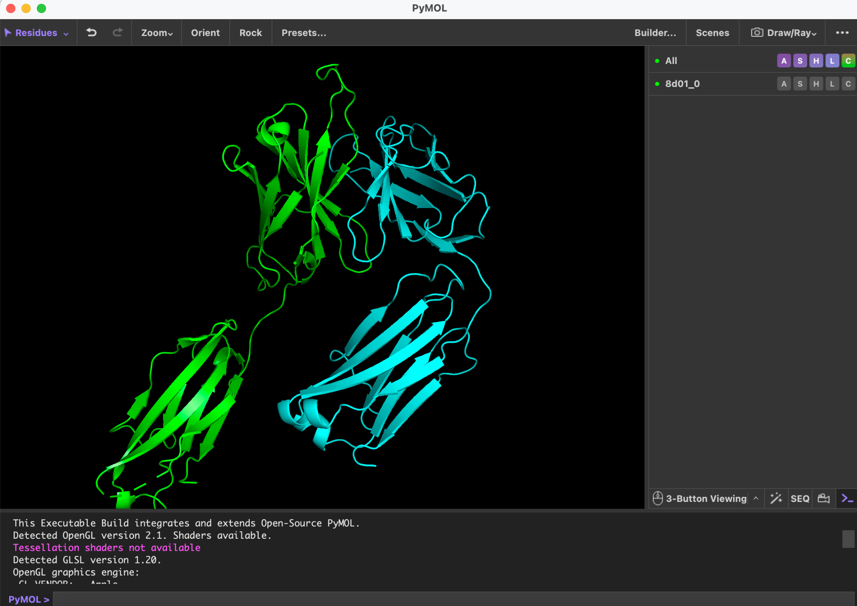
Views

Slide 6

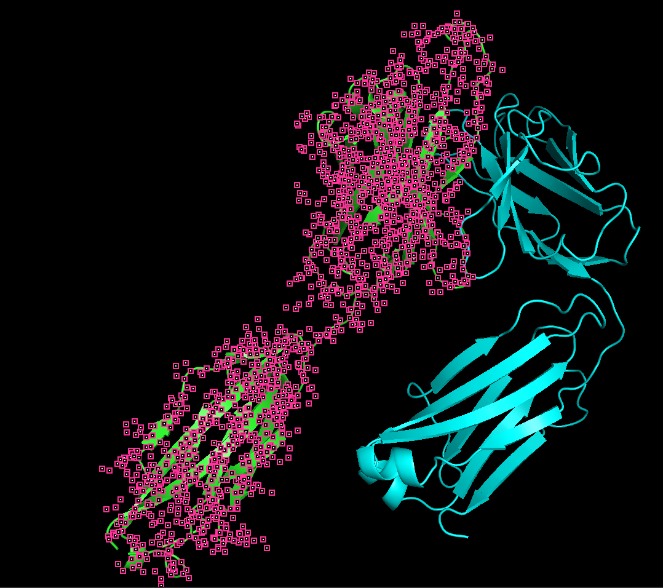
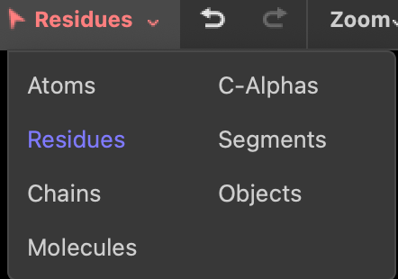
Interactive selections

Slide 7
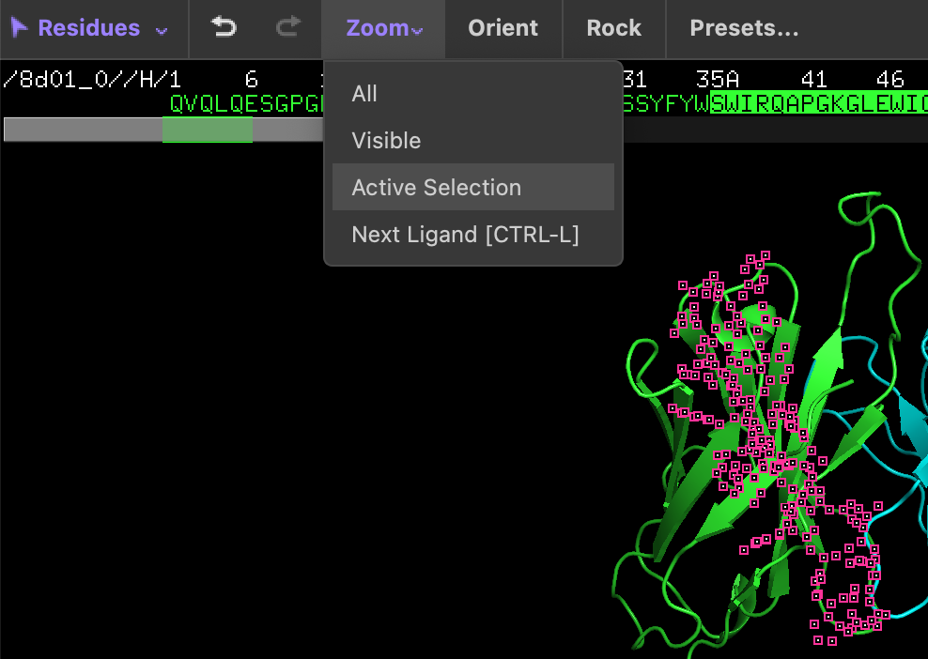
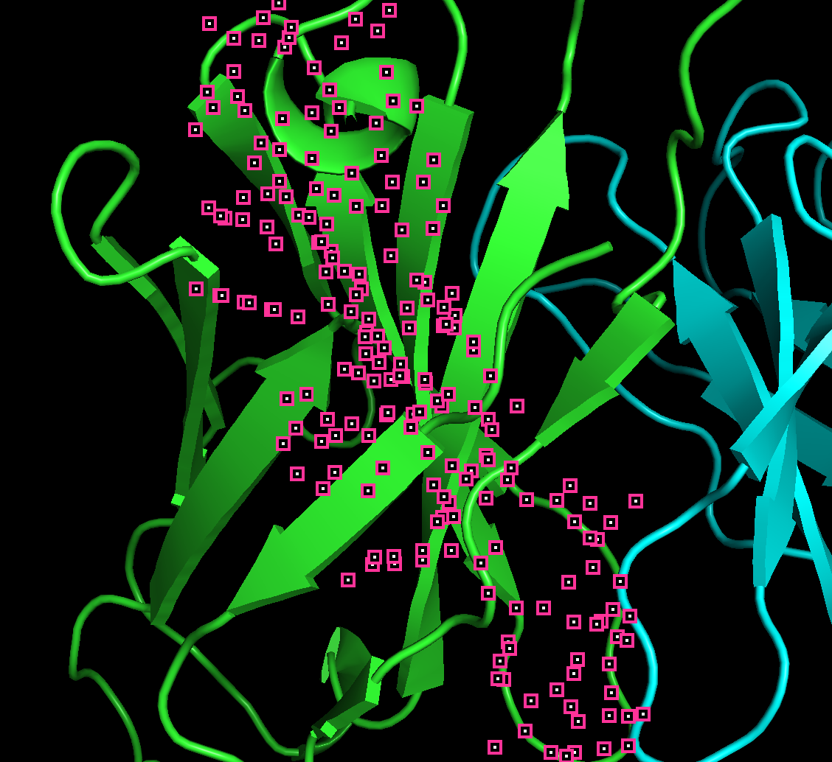
Zooming

Slide 8
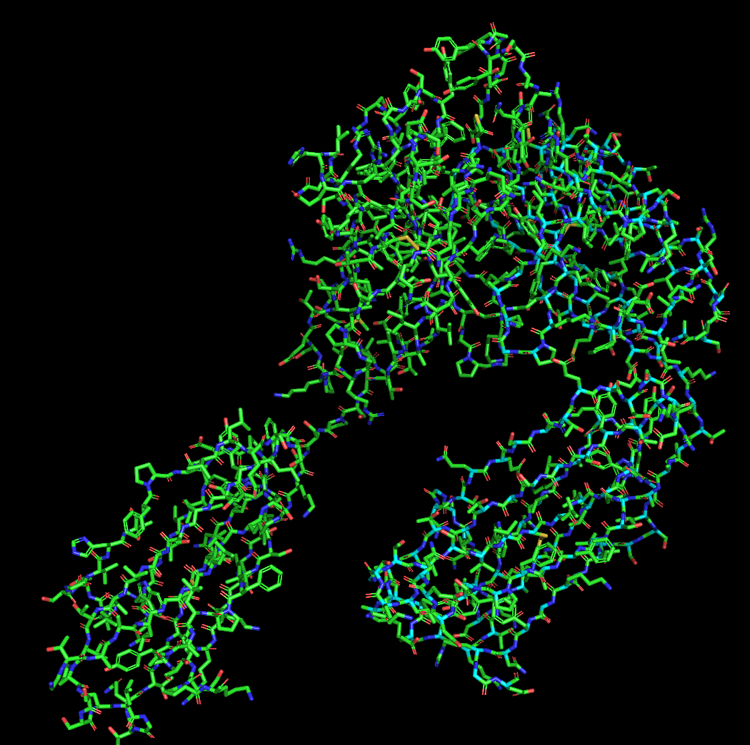
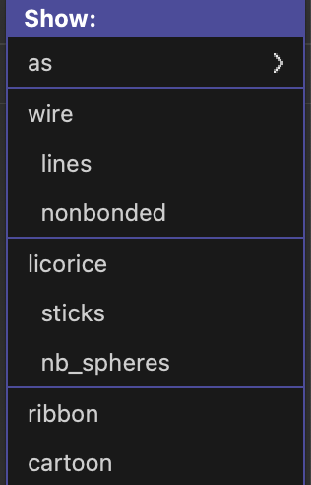
Show as

Slide 9
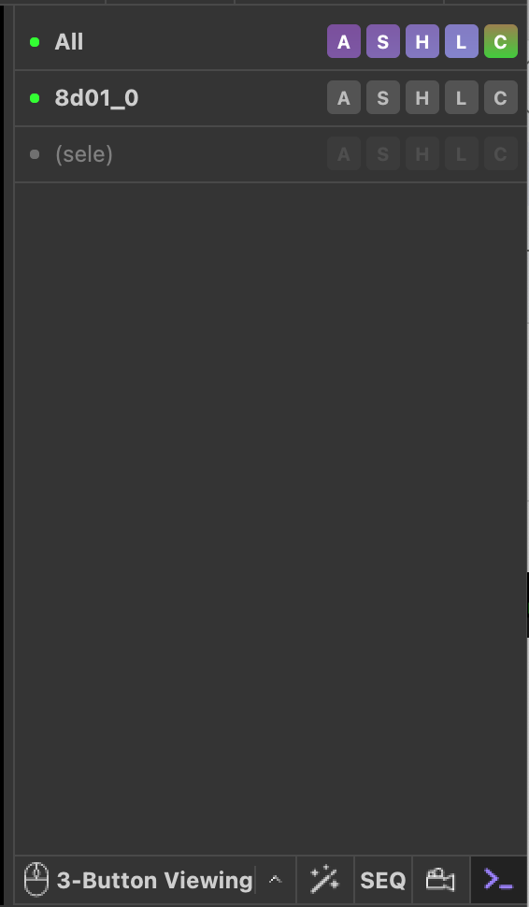
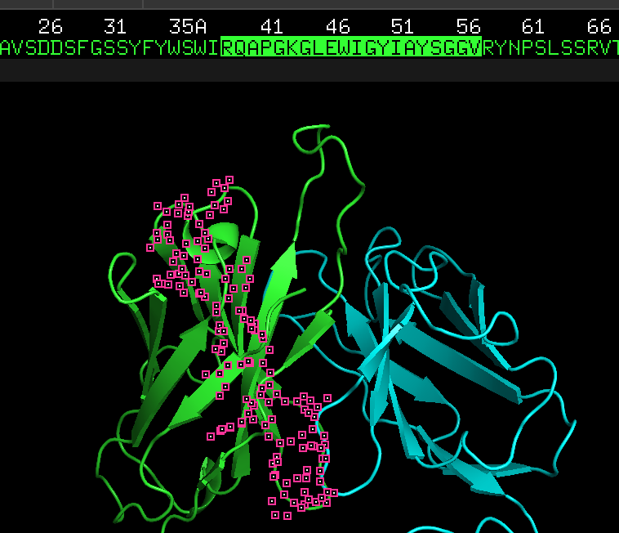
Sequence and structure

Slide 10
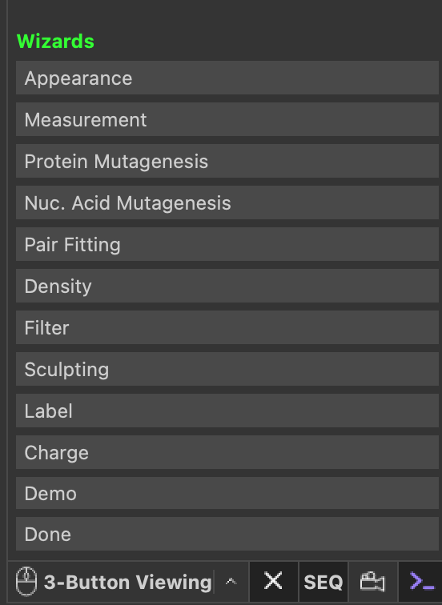
Wizard

Slide 11

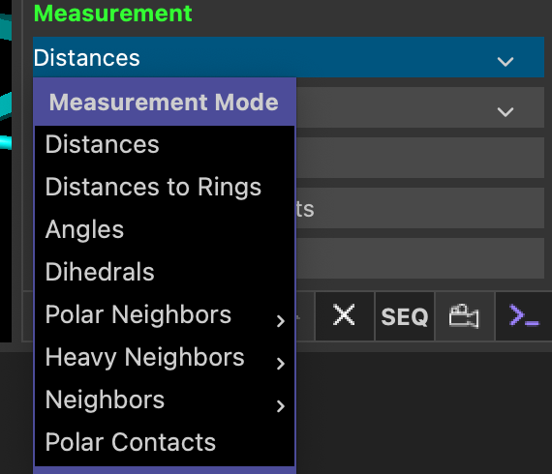

Wizard

Slide 12
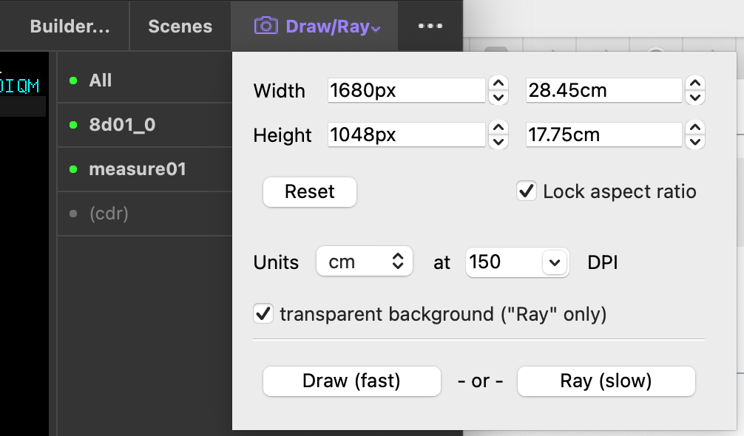
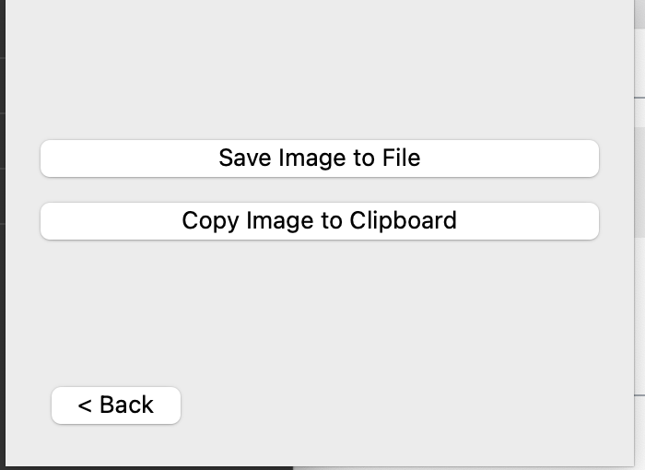
Saving figures

Slide 13
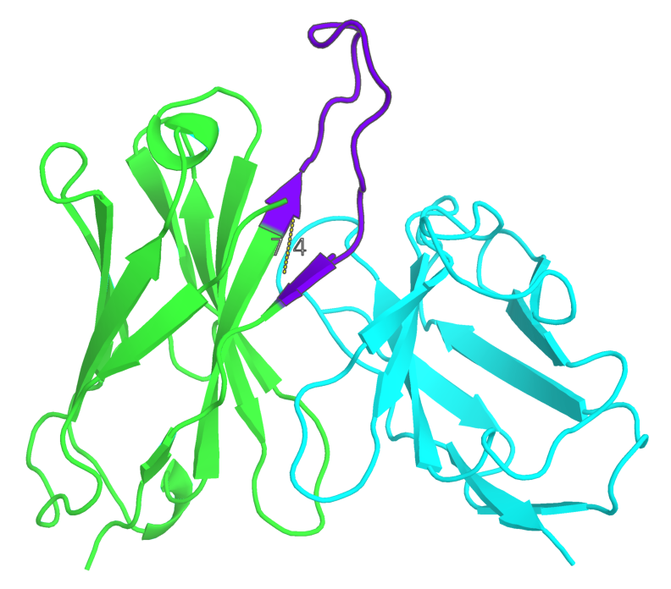
Saving figures

Slide 14
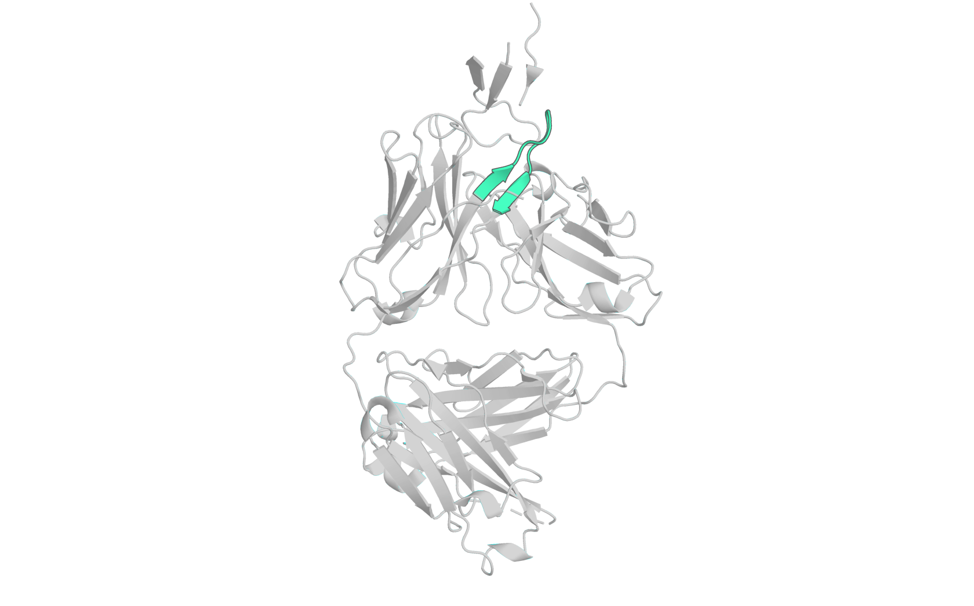

Slide 15
Commands
PyMol’s GUI provides way to select regions, residues, atoms etc. so you can highlight the parts of the molecules you’re interested in, calculate RMSD against other objects, etc.
You can select these regions and store them in an object and then use it later!
PyMol has a “Wizard”, that allows you to measure quantities such as bond distances, angles, dihedrals etc.
RMSD calculations are a heavily used function, which PyMol accomplishes through fitting both sequence and structure.

Slide 16
Figures: PyMol has a ton of settings to optimize viewing molecules.
Color
By chain
Any color you want
Rainbows (get an idea of where a protein starts + ends)
Bfactors → Can represent (1) temperature (2) pLDDT
Molecular representation
Cartoon
Stick
Etc.
Opacity
set_cartoon_transparency, object, <alpha>
Setting this to anything but 0 removes tracing. Set transparency to 0 for a region you want to highlight, and the rest to 0.05 to get a trace over your region of interest for excellent figures.

Slide 17
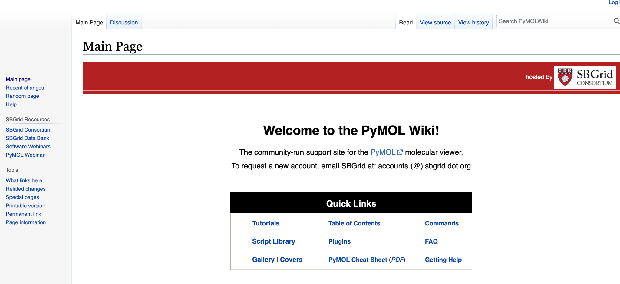
For more pymol commands:
pymolwiki.org

Slide 18

Visual Studio Code

Slide 19
Getting started with VSCode
VSCode is one of the most popular IDEs for coding.
It allows you to increase functionality through downloadable extensions
Very personalizable interface: you can simplify or add as many windows to your screen as you’d like, and can edit the aesthetics using community extensions!
Look into Tmux (https://www.redhat.com/en/blog/introduction-tmux-linux)
Helps you disengage running processes from your current terminal window so they can run in the background, and closing your local desktop doesn’t matter
Learn more at:
https://code.visualstudio.com/docs/introvideos/basics

Slide 20
VSCode interface tour

Slide 21
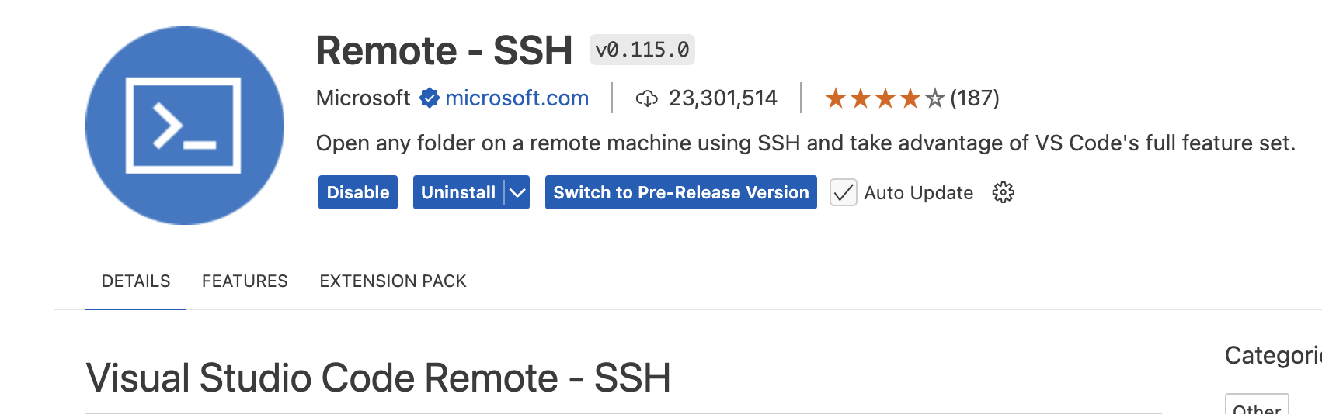
SSHing into a computer cluster using VSCode
Install an SSH client extension to VSCode:
Extra guide: https://code.visualstudio.com/docs/remote/ssh

Slide 22

SSHing into a computer cluster using VSCode
2) Click on the symbol on the bottom left corner of the screen
3) in the box on the top of the screen, type in the ssh command (usually <id>@host.extension)
4) install any extensions needed for the language you want to use in ssh. At that point VSCode will have some pop ups that will guide you through the process.
Here’s an additional step by step tutorial: https://code.visualstudio.com/docs/remote/ssh-tutorial
Technical info: https://code.visualstudio.com/docs/remote/ssh

Slide 23
Mini-lesson on using PyMol
https://graylab.jhu.edu/pyrosetta/downloads/documentation/pyrosetta4_online_format/PyRosetta4_Workshop1_PyMOL.pdf

Slide 24
Extras

Slide 25
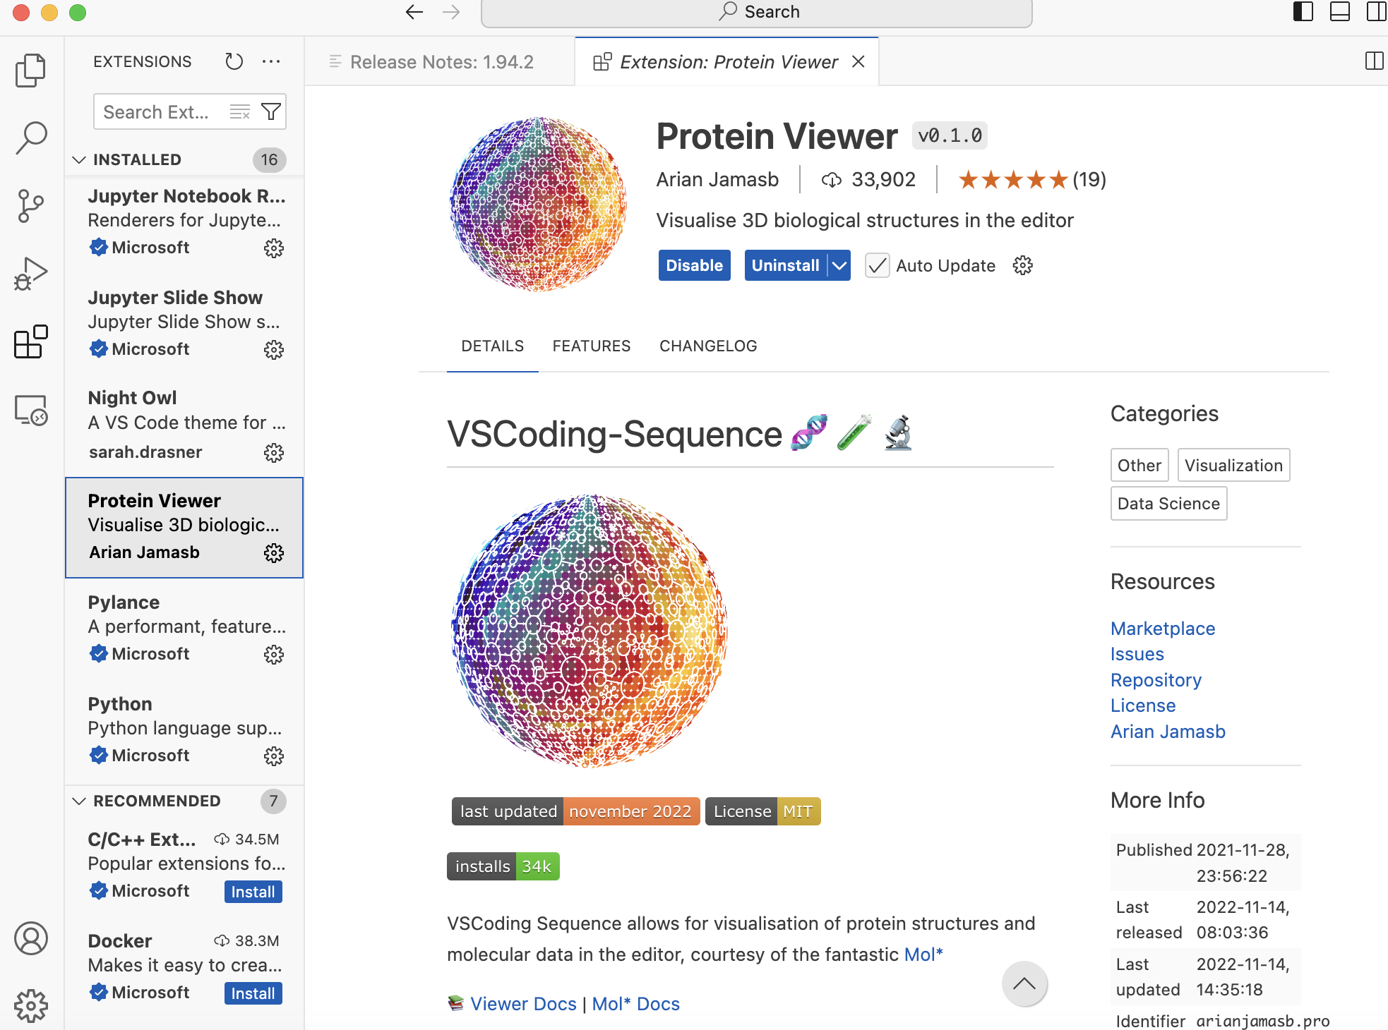
Viewing proteins remotely through VSCode
(2)
Useful for viewing proteins on computer cluster without having to move them to your local desktop.
(1)
Doc:
https://molstar.org/viewer-docs/

Slide 26
Protein Viewer Functionality
Color like PyMol:
Region, hydrophobicity, secondary structure, residue order etc.
RMSD calculation
Measurements
Can toggle between chains and parts of the structure by clicking dropdown menu at top.
Can click through multiple models in the NMR structure files
Can also take snapshots and directly make animated movies.

Slide 27
Jupyter notebooks
Jupyter notebooks are a file format that can be used for many different languages, and basically break up code into cells.
Jupyter notebooks are very useful for writing scratch code, setting up coding experiments, and plotting, particularly for large datasets you have stored in computer clusters!
VSCode has a jupyter notebook extension that lets you use jupyter notebooks even when sshing. To create a jupyter notebook remotely using VSCode, use the command
code -r <filename>.ipynb
More documentation on notebooks can be found on the site: https://docs.jupyter.org/en/latest/

Slide 28
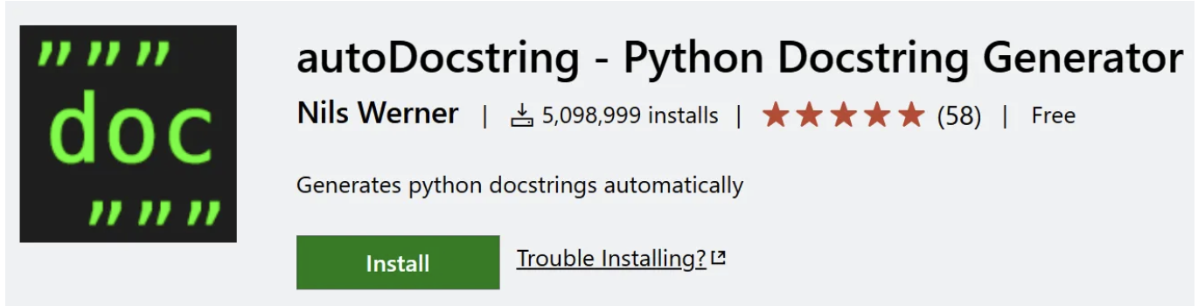
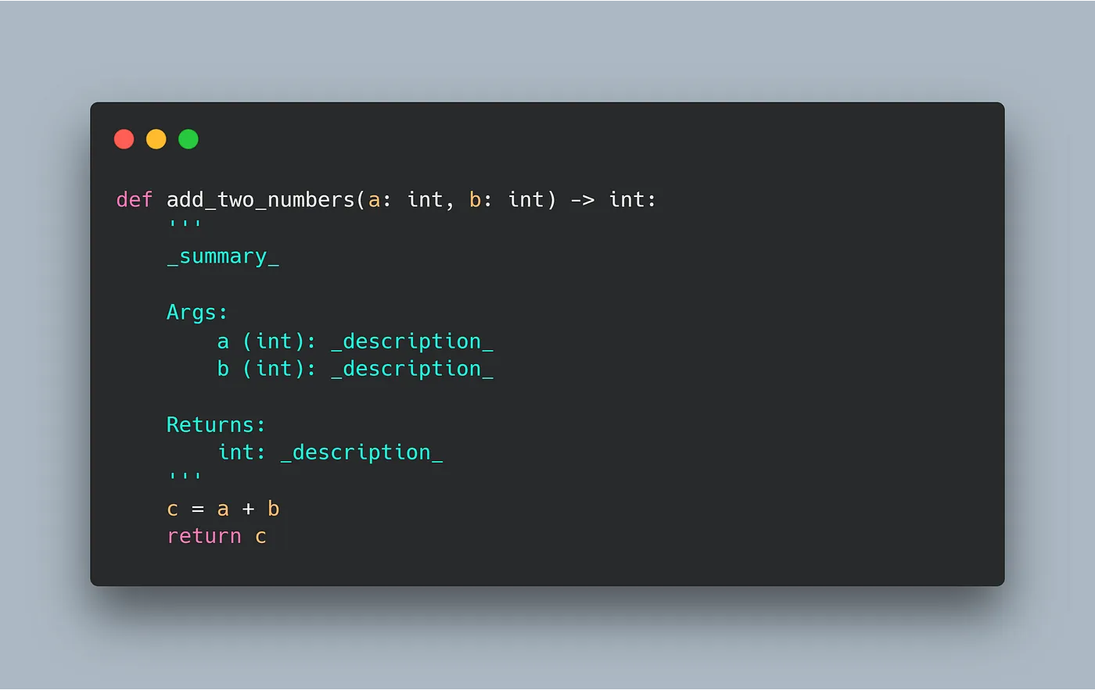
Auto docstring extension
https://leowu507.medium.com/how-to-make-writing-docstrings-quick-and-easy-in-vs-code-e6ddfcd0504d

Slide 29
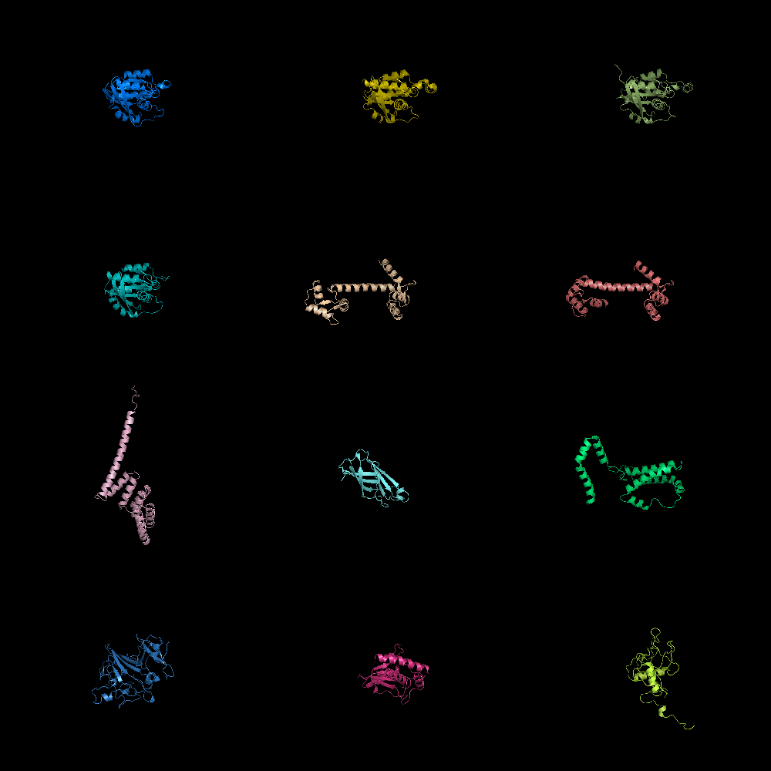
Gridmode
# turn on grid mode
set grid_mode,1
# turn off grid mode
set grid_mode,0
pymolwiki

